Slide 1

2011 ANNUAL REPORT
2010 REAL ESTATE IN REVIEW
Written
by
Tony Lindauer
Jefferson County PVA
and
Donna Hunt, Chief Deputy
March 15, 2011
© Jefferson County PVA

Slide 2
Residential Real Estate
WHAT HAPPENED TO THE REAL ESTATE MARKET?
WHERE WAS THE MARKET IN 2010?
WHAT IS THE FUTURE OF LOUISVILLE METRO HOUSING MARKET?

Slide 3
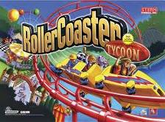
WHERE HAVE WE BEEN?
We started this Roller Coaster Ride of Home Values in 2008

Slide 4
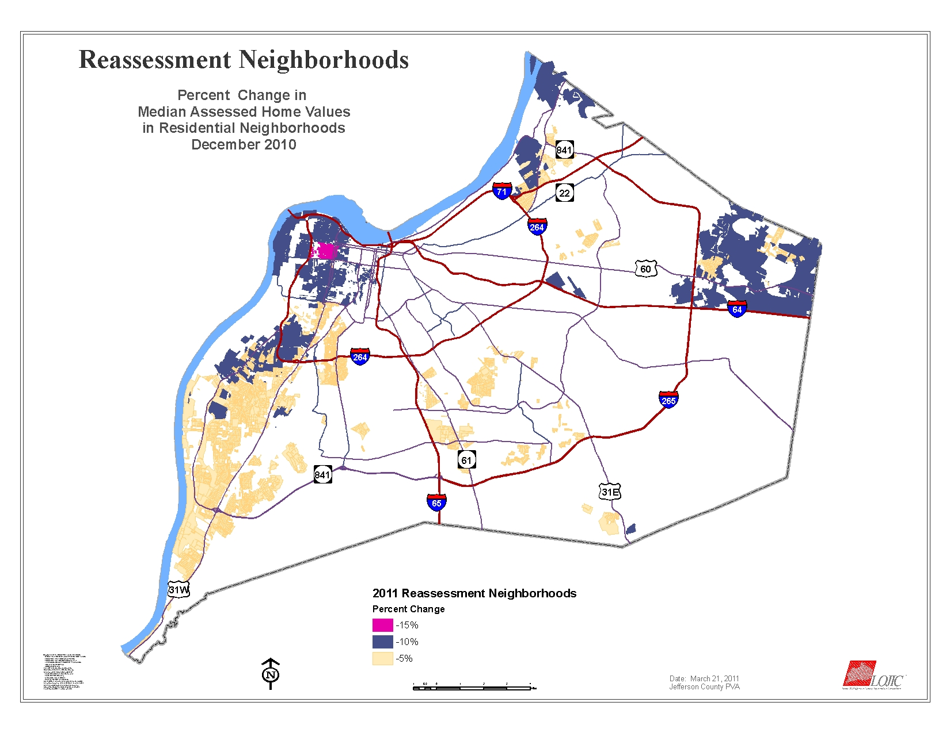

Slide 5
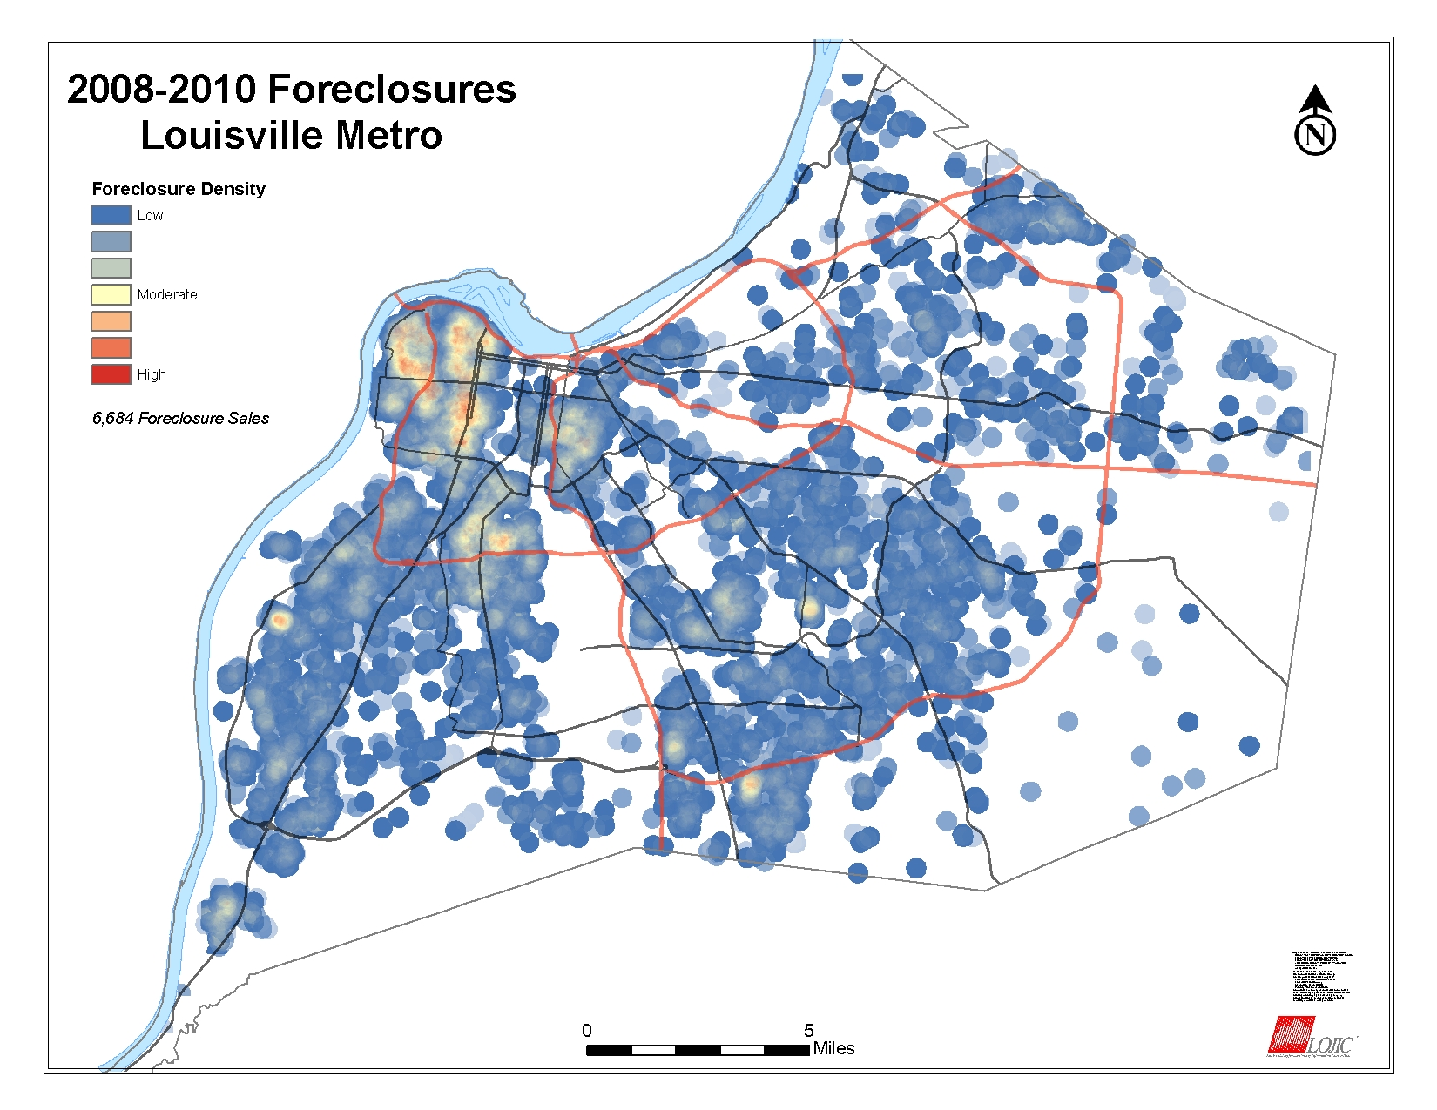

Slide 6
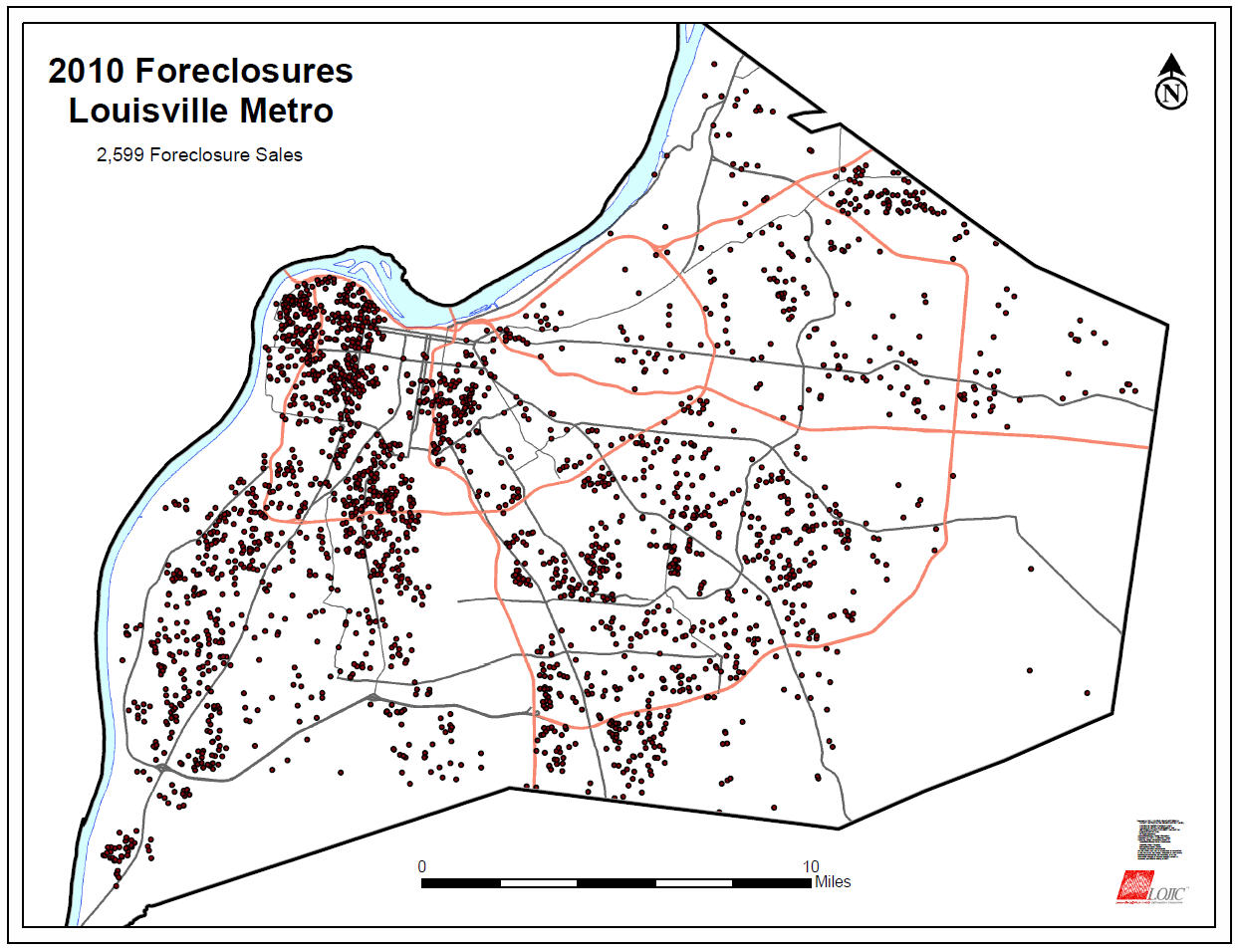
2010 represents 39%
of the total amount of
foreclosures between 2008-2010

Slide 7
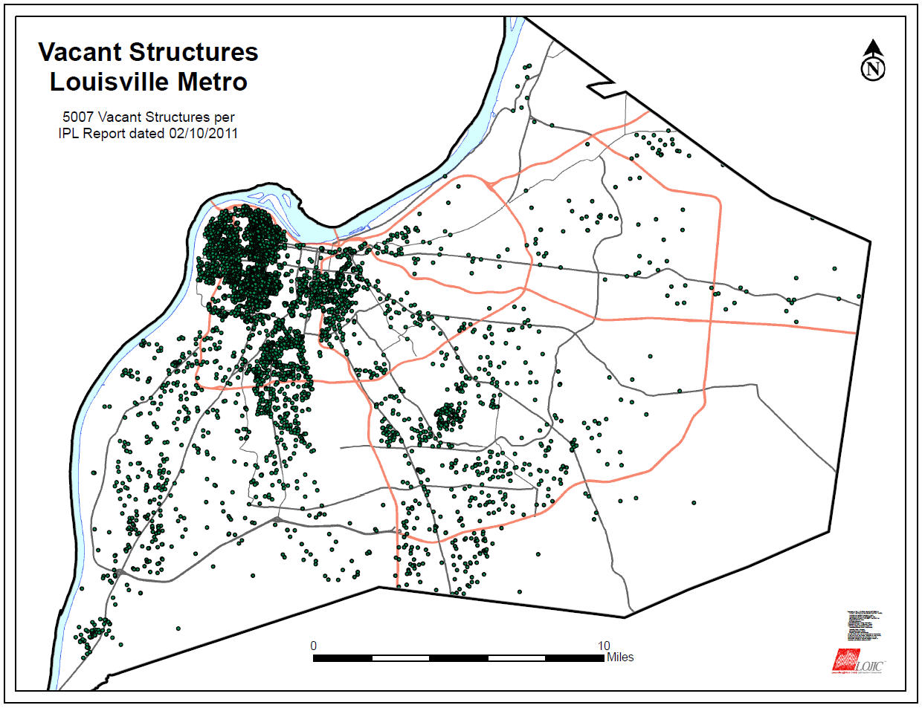

Slide 9
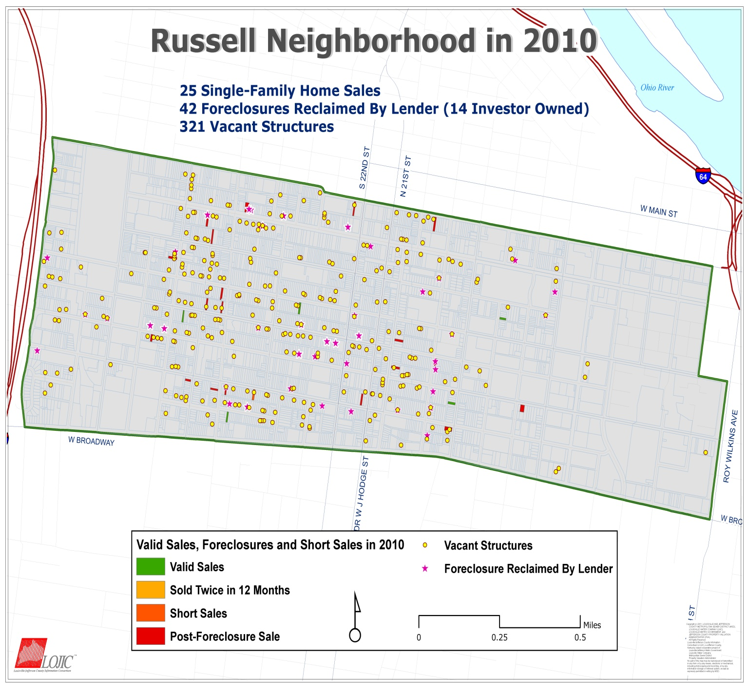

Slide 10
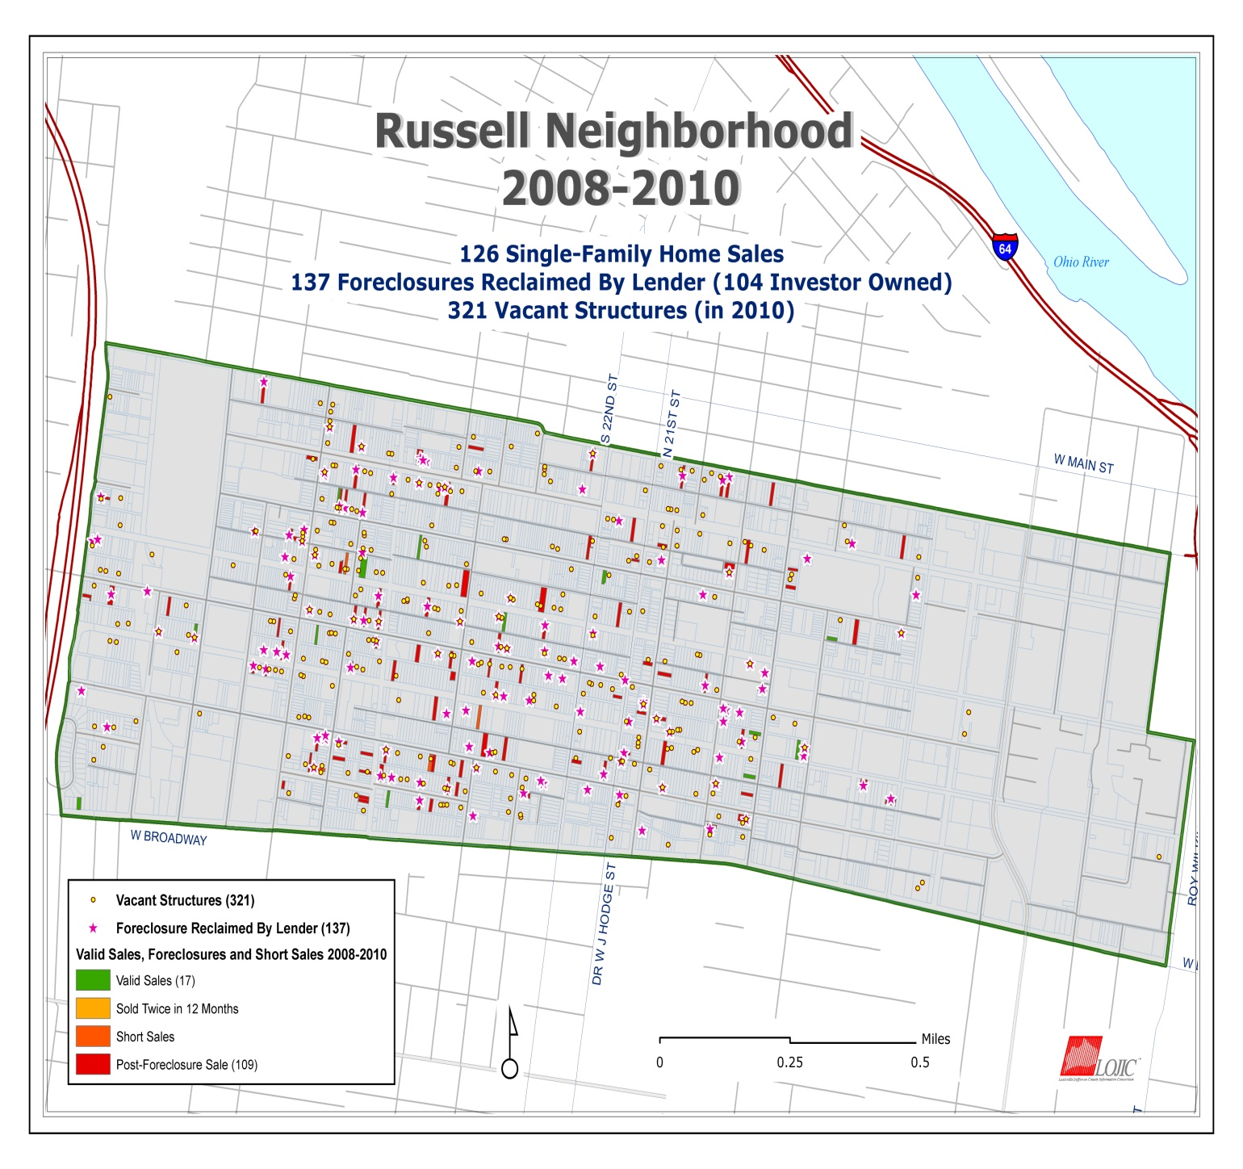

Slide 11
1997-2010 Appreciation 2nd and 4th Quarters
The graph depicts changes starting in 2008 fourth quarter until the end of 2010 4th quarter. Appreciation was relatively flat for the year.

Slide 12
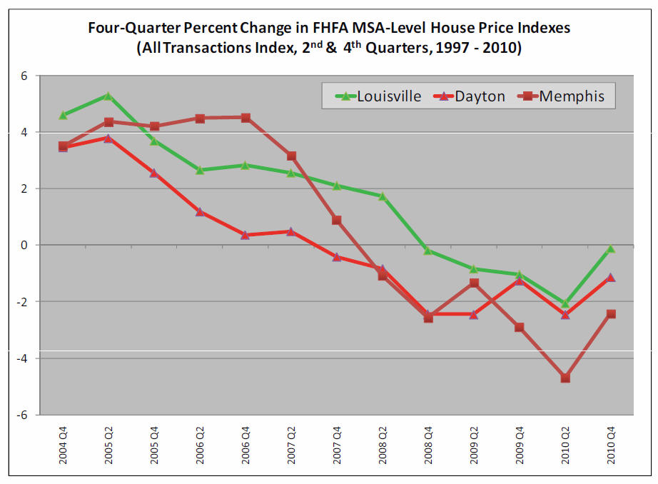

Slide 13
4th Quarter 2010
2010 Appreciation
Louisville Metro lost a small percentage of appreciation in the past year, but values in Louisville Metro and the surrounding MSA area is far better than the majority of comparative cities. This graph depicts 4th quarter of 2010.

Slide 14
1997-2010 Appreciation 2nd and 4th Quarters
In comparison to more volatile markets, Louisville is relatively stable. We are back to the 2008 level before the recession began.

Slide 15
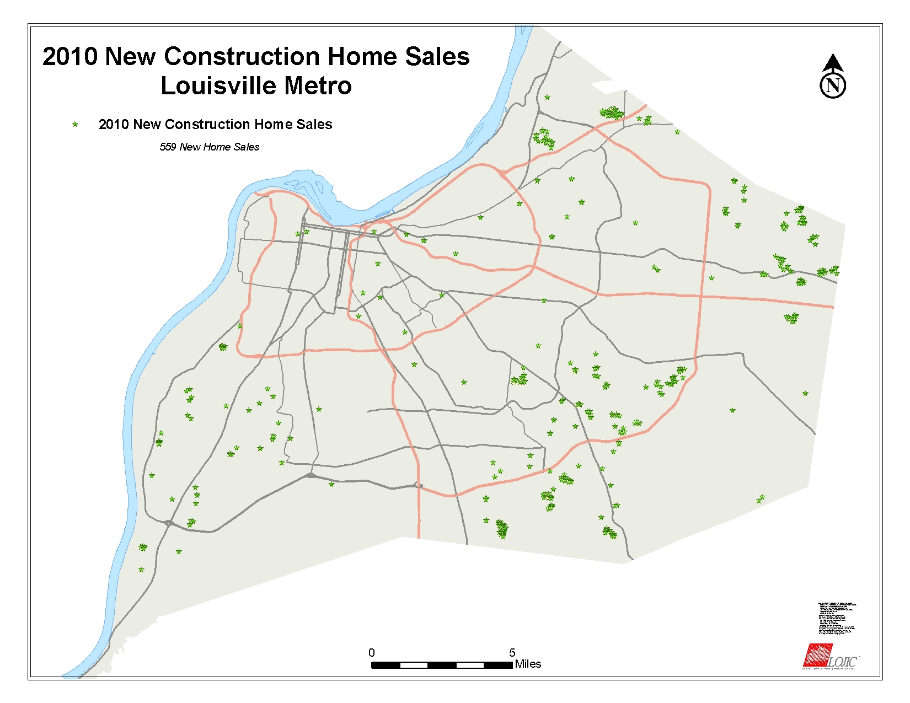
New Housing In Jefferson County
Louisville/Jefferson County Metro
2010 Building Permits
Single Family 639
Condos/Patio Homes 36
Multi-Family 18
4 New Subdivisions Recorded
In 2010
Trotter’s Meadow
Chism Trail
Urton Woods
Creek View

Slide 16
Commercial Real Estate
Even with the current economic downturn, several new projects were completed in Louisville during the year.
The Skywalk was built to connect the Galt House hotel and Waterfront Plaza with the Yum Center.
A Skywalk Garage with 860 parking spaces was completed near the
the arena.
American Urgent Care Holdings LLC built a 3 story building on Roy
Wilkins Avenue.
Patrick O’Shea’s Public House was built on Main Street.
Jefferson Community & Technical College built a 4 story instructional building for allied health programs.
Louisville Metro Housing Authority built a Community Center for Liberty Green.

Slide 17
Commercial Real Estate
New projects Continued:
Sons of the Revolution renovated the NSSAR Genealogical Research Library on West Main Street.
Parking Authority of River City constructed the Yum Center Garage with 760 parking spaces.
Smith Investment Group II LLC renovated the Independence Building on Muhammad Ali Boulevard.
TARC built a Maintenance Annex.
U of L constructed a parking garage with 1,711 spaces near the Health Sciences campus.
U of L renovated the Cardiovascular Innovation Institute.
U of L constructed the U of L Boat House at Waterfront Park.

Slide 18
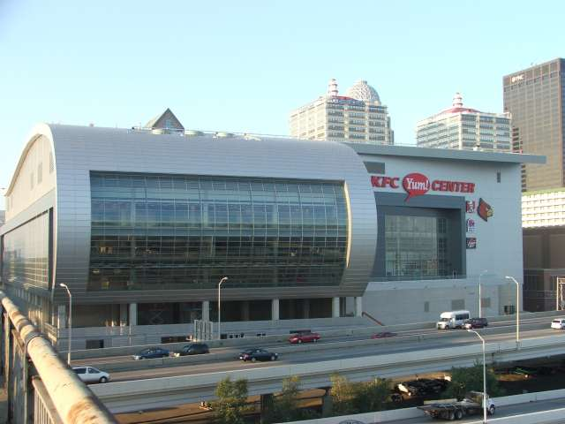
The KFC YUM! Center Area
The area around the new KFC Yum Center is creating a lot of redevelopment for living areas, restaurants, and entertainment. Further development is underway and the planned renovation/building of Whiskey Row will certainly add to the excitement that has been generated by the arena.

Slide 19
Manufacturing
The latest industry statistics indicate the Louisville/Jefferson County area lost over 31,000 manufacturing jobs in the last decade.
New development is slow.
Financial markets are more strict requiring additional equity investments, however increased production at the Louisville Ford Assembly Plant as well as General Electric are very encouraging signs for our manufacturing industry.

Slide 20
Retail
Retail continues to struggle, however; there are several areas that have some new retail. Westport Village, and Shelbyville Road Plaza are two of the newest small retail centers that are attracting new stores after major
renovations.
The regional malls of Oxmoor Center, Mall St Mathews and Jefferson Mall are continuing to attract new stores and vacancy rates are low.
Small strip centers continue to struggle to attract new retail.
Several hometown businesses have expanded to new areas.

Slide 21
WHAT DOES THE FUTURE HOLD
for the METRO LOUISVILLE HOUSING MARKET?
Future of our market depends on creating and maintaining jobs, or as Mayor Fischer would say
Jobs………..Jobs………………Jobs
We want also to add
Education…..Education….Education
Advanced Technical Training or College Degree
Interest rates will probably continue to edge up. As of the writing of this report current interest rates hover around 5% for a 30 year fixed loan. Most banks are requiring a 20% down payment.
There are fewer homeowners in the market place. In 2000 64.9% owned Homes in Louisville. Homeownership went as high as 66.5% in 2007 and at the end of 2009, that number had dropped to 63.6% according to the US Census Bureau. A lot of former homeowners went back to renting. Homeownership is not for everyone.

Slide 22
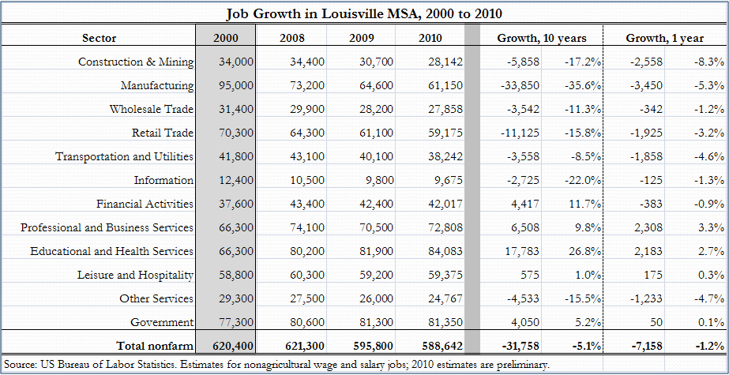
Job Growth

Slide 23
More expensive homes are still not selling for prices they were 36 months ago. Therefore, it appears the Louisville market is overbuilt for more expensive homes. This price level will continue to be a buyer’s market for quite some time.
As the job market improves, interest rates remain relatively low, and the stock market continues to rise, confidence levels of buyers will increase and we hope 2011 will be a much better year for Metro Louisville Real Estate.
The Middle East is wreaking havoc with gas prices that holds us hostage and that could delay economic recovery. We also don’t know how the effect the disasters in Japan will affect our recovery.
Kentucky Realtor Association president says it's an
'ideal environment' for buyers
These are only estimates of where the Property Valuation Office sees the market for the next year. As we all know, there are many variables at play in the Real Estate Market.

Slide 24
Written by
Tony Lindauer, PVA
And Donna Hunt, Chief Deputy
March 11, 2010
Contributions by:
Paul Coomes, Ph.D. Professor of Economics at University of
Louisville
Greater Louisville Association of Realtors
Homebuilders Association of Louisville
Metro Dept of Inspections, Permits, and Licenses
Master Commissioner of Jefferson County
Graphs, Charts, Maps produced by Jefferson County PVA Internal
Technology Department
Jefferson County PVA
502-574-6380
www.jeffersonpva.ky.gov.
© Jefferson County PVA

